Slide 1


Carlos Ortiz
06 October 2022

Slide 2

Outline
Executive Summary
Introduction
Methodology
Results
Conclusion
Appendix

Slide 3
Executive Summary
Methodologies: the methodologies used in this capstone were data analysis throw data wrangling, exploratory data using visualization and SQL, interactive visual and Perform predictive analysis using classification models.
Results: with the data analyzed we realized that the experience is a big success factor in rocket launching and the classification models trend to the same result a accuracy of 83%.

Slide 4
Introduction
We will predict if the Falcon 9 first stage will land successfully. SpaceX advertises Falcon 9 rocket launches on its website, with a cost of 62 million dollars; other providers cost upward of 165 million dollars each, much of the savings is because SpaceX can reuse the first stage. Therefore if we can determine if the first stage will land, we can determine the cost of a launch. This information can be used if an alternate company wants to bid against SpaceX for a rocket launch.

Slide 5

Section 1

Slide 6
Methodology
Executive Summary
Data collection methodology:
The data was collected using web scrapping, space X API and a JSON file provided.
Perform data wrangling
The data was processed using Exploratory Data Analysis and Determine Training Labels
Perform exploratory data analysis (EDA) using visualization and SQL
Perform interactive visual analytics using Folium and Plotly Dash
Perform predictive analysis using classification models

Slide 7
Data Collection
The data sets were collected using a API form space X this API will help us use the extract information using identification numbers in the launch data.
We use request and parse the SpaceX launch data using the GET request of a JSON file.
Also using the API to get information about the launches using the IDs given for each launch. Specifically we will be using columns rocket, payloads, launchpad, and cores.
Finally construct our dataset using the data we have obtained. We combine the columns into a dictionary.

Slide 8
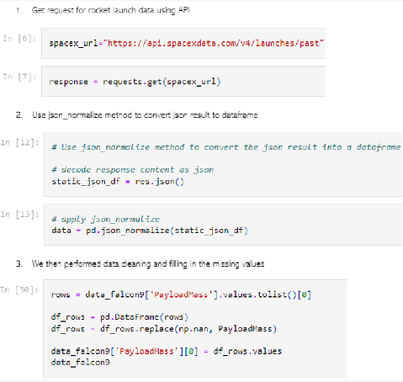
Data Collection – SpaceX API
All the datra
Here you can find the completed code cell and outcome cell in my GitHub : https://github.com/CarlosOrtiz-21/SpaceX_Data/blob/main/1.%20jupyter-labs-spacex-data-collection-api%20CO.ipynb

Slide 9
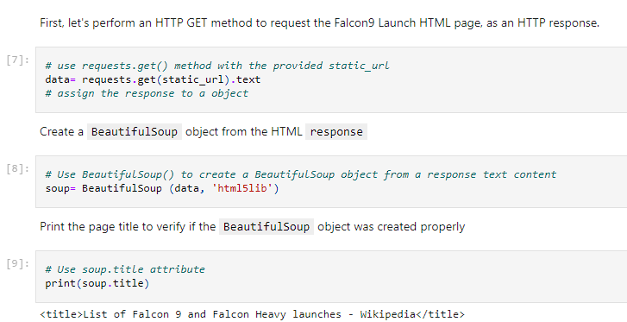
Data Collection - Scraping
We use Beautiful Soup library to web scrap Falcon 9 launch records
We parsed the table and converted it into a panda data frame
Github:https://github.com/CarlosOrtiz-21/SpaceX_Data/blob/main/2.%20jupyter-labs-webscraping.ipynb

Slide 10
Data Wrangling
We performed exploratory data analysis and determined the training labels.
We calculated the number of launches at each site, and the number and occurrence of each orbits
We created landing outcome label from outcome column and exported the results to csv.
GitHub URL: https://github.com/CarlosOrtiz-21/SpaceX_Data/blob/main/3.%20labs-jupyter-spacex-Data%20wrangling%20.ipynb

Slide 11
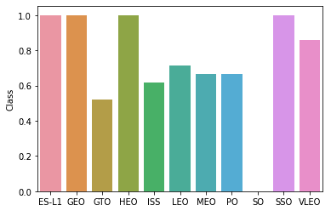
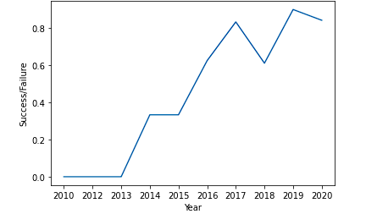
EDA with Data Visualization
We explored the data by visualizing the relationship between flight number and launch Site, payload and launch site, success rate of each orbit type, flight number and orbit type, the launch success yearly trend.
GitHub URL: https://github.com/CarlosOrtiz-21/SpaceX_Data/blob/main/5.%20jupyter-labs-eda-dataviz%20.ipynb

Slide 12
EDA with SQL
We loaded the SpaceX dataset into a PostgreSQL database without leaving the jupyter notebook.
We applied EDA with SQL to get insight from the data. We wrote queries to find out for instance:
The names of unique launch sites in the space mission.
The total payload mass carried by boosters launched by NASA (CRS)
The average payload mass carried by booster version F9 v1.1
The total number of successful and failure mission outcomes
The failed landing outcomes in drone ship, their booster version and launch site names.
GitHub URL: https://github.com/CarlosOrtiz-21/SpaceX_Data/blob/main/4.%20jupyter-labs-eda-sql-coursera_sqllite_.ipynb

Slide 13
Build an Interactive Map with Folium
We marked all launch sites, and added map objects such as markers, circles, lines to mark the success or failure of launches for each site on the folium map.
We assigned the feature launch outcomes (failure or success) to class 0 and 1.i.e., 0 for failure, and 1 for success.
Using the color-labeled marker clusters, we identified which launch sites have relatively high success rate.
We calculated the distances between a launch site to its proximities. We answered some question for instance:
Are launch sites near railways, highways and coastlines.
Do launch sites keep certain distance away from cities.

Slide 14
Build a Dashboard with Plotly Dash
We built an interactive dashboard with Plotly dash
We plotted pie charts showing the total launches by a certain sites
We plotted scatter graph showing the relationship with Outcome and Payload Mass (Kg) for the different booster version.
GitHub URL : https://github.com/CarlosOrtiz-21/SpaceX_Data/blob/main/spacex_dash_app.py

Slide 15
Predictive Analysis (Classification)
We loaded the data using numpy and pandas, transformed the data, split our data into training and testing.
We built different machine learning models and tune different hyperparameters using GridSearchCV.
We used accuracy as the metric for our model, improved the model using feature engineering and algorithm tuning.
We found the best performing classification model.
GitHub URL: https://github.com/CarlosOrtiz-21/SpaceX_Data/blob/main/7.%20SpaceX_Machine%20Learning%20Prediction_Part_5.ipynb

Slide 16
Results
Exploratory data analysis results
Interactive analytics demo in screenshots
Predictive analysis results

Slide 17

Section 2

Slide 18
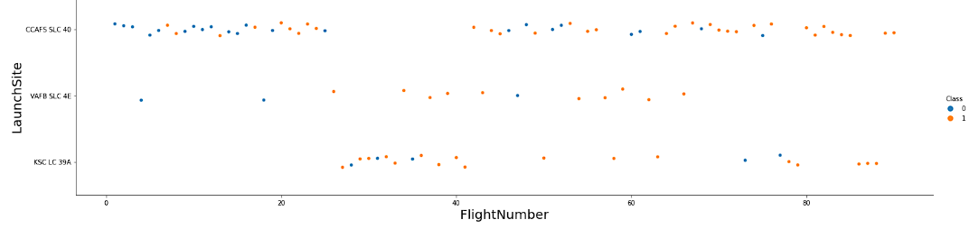
Flight Number vs. Launch Site
From the plot, we found that the larger the flight amount at a launch site, the greater the success rate at a launch site.

Slide 19
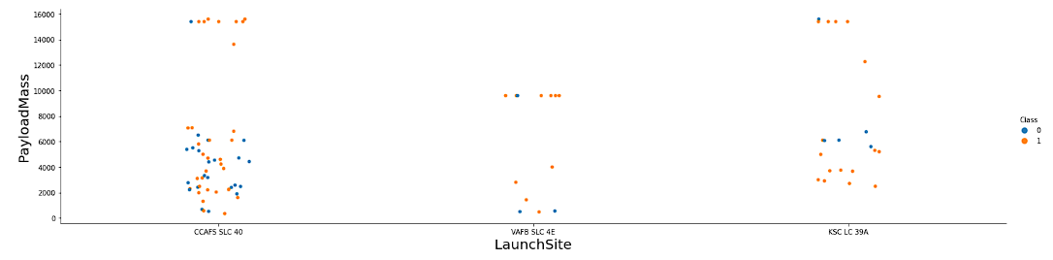
Payload vs. Launch Site
The greater the payload mass for lauch site CCAFS SLA 40 the higher the succes rate for the lauching

Slide 20
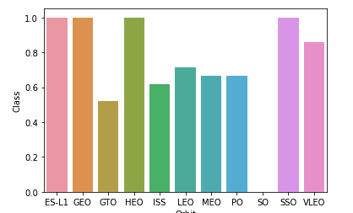
Success Rate vs. Orbit Type
We can appreciate that the Orbit type ES-LI, GEO , HEO, SSO, VLEO have the best successful rates.

Slide 21
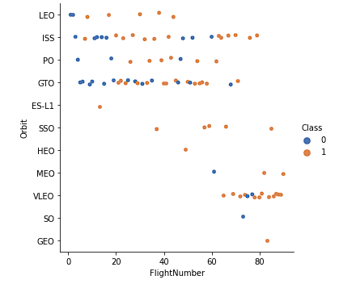
Flight Number vs. Orbit Type
We see that in the LEO orbit the Success appears related to the number of flights; on the other hand, there seems to be no relationship between flight number when in GTO orbit.

Slide 22
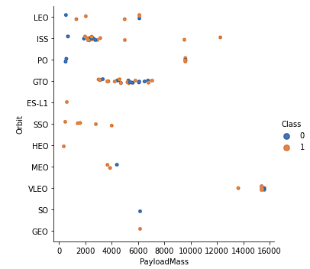
Payload vs. Orbit Type
With heavy payloads the successful landing or positive landing rate are more for Polar,LEO and ISS.
However for GTO we cannot distinguish this well as both positive landing rate and negative landing(unsuccessful mission) are both there here

Slide 23
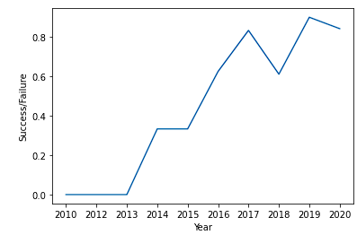
Launch Success Yearly Trend
We can observe that the success rate since 2013 kept increasing till 2020.
Each launching is more experience gained in that its what we appreciate in the graph.

Slide 24
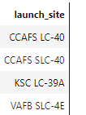
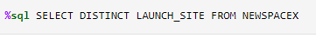
All Launch Site Names
The names of the unique launch sites

Slide 25
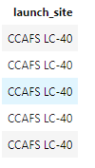
Launch Site Names Begin with 'CCA'
5 records where launch sites begin with `CCA`

Slide 26
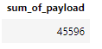
Total Payload Mass
We Calculate the total payload carried by boosters from NASA

Slide 27
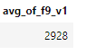
Average Payload Mass by F9 v1.1
We Calculate the average payload mass carried by booster version F9 v1.1

Slide 28

First Successful Ground Landing Date
We observed that the dates of the first successful landing outcome on ground pad was 22nd December 2015.

Slide 29
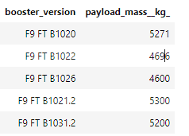
Successful Drone Ship Landing with Payload between 4000 and 6000
This is the List names of boosters which have successfully landed on drone ship and had payload mass greater than 4000 but less than 6000

Slide 30
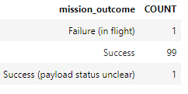
Total Number of Successful and Failure Mission Outcomes
Total number of successful and failure mission outcomes

Slide 31
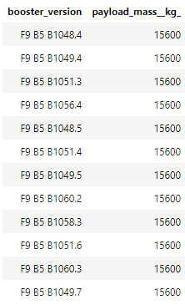
Boosters Carried Maximum Payload
We determined the booster that have carried the maximum payload using a subquery in the WHERE clause and the MAX() function.

Slide 32

2015 Launch Records
We used a combinations of the WHERE clause, LIKE, AND, and BETWEEN conditions to filter for failed landing outcomes in drone ship, their booster versions, and launch site names for year 2015

Slide 33

Rank Landing Outcomes Between 2010-06-04 and 2017-03-20
We selected Landing outcomes and the COUNT of landing outcomes from the data and used the WHERE clause to filter for landing outcomes BETWEEN 2010-06-04 to 2010-03-20.
We applied the GROUP BY clause to group the landing outcomes and the ORDER BY clause to order the grouped landing outcome in descending order.

Slide 34

Section 3

Slide 35

All launch sites global map markers

Slide 36

Markers showing launch sites with color

Slide 37

Launch Site distance to landmarks

Slide 38

Section 4

Slide 39

Pie chart showing the success percentage achieved by each launch site

Slide 40

Pie chart showing the Launch site with the highest launch success ratio

Slide 41

Scatter plot of Payload vs Launch Outcome for all sites, with different payload selected in the range slider

Slide 42

Section 5

Slide 43
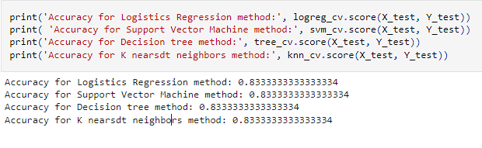
Classification Accuracy
The method performs best practically are the same.

Slide 44
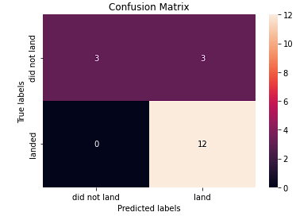
Confusion Matrix
The confusion matrix for the decision tree classifier shows that the classifier can distinguish between the different classes. The major problem is the false positives .i.e., unsuccessful landing marked as successful landing by the classifier.

Slide 45
Conclusions
We can conclude that:
The larger the flight amount at a launch site, the greater the success rate at a launch site.
Launch success rate started to increase in 2013 till 2020.
Orbits ES-L1, GEO, HEO, SSO, VLEO had the most success rate.
KSC LC-39A had the most successful launches of any sites.
The Decision tree classifier is the best machine learning algorithm for this task.

Slide 46
Appendix
Python
SQL
Jupiter Notebooks
IBM DB2
Space X Data set

Slide 47


